Slide 1
LDO (Low Drop Out) Regulator
Presented By
Madhukar Saini

Slide 2
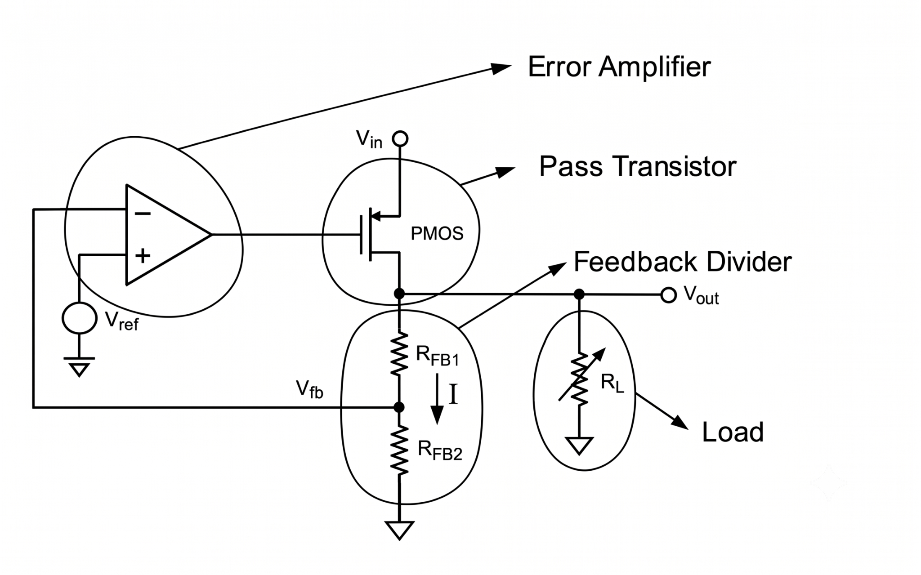
Circuit - LDO regulator
LDO provides constant output voltage even when the load changes
Error Amplifier forces both of its inputs to be the same, resulting the current adjustment in pass transistor.
I = V_{fb} (approx. V_{ref})/R_{FB2}
V_{ref} usually comes from BGR, BGR won't be able to provide constant voltage by itself when the load changes.
Here Pass Transistor current can be adjusted through Error Amplifier output voltage to make
V_{fb} = V_{ref}
To give V_{fb} = V_{ref} we will choose R_{FB2} = V_{ref}/I and RFB1 = (V_{OUT} - V_{ref})/I
Fluctuations in VDD gets cancelled with the noise at the gate of the pass transistor if we use PMOS Pass transistor resulting good PSRR.

Slide 3
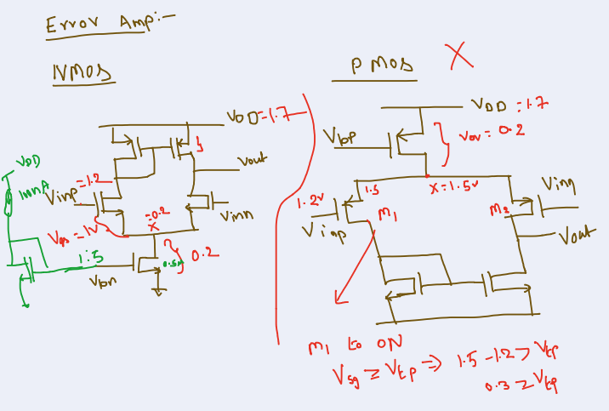
Why PMOS Error Amplifier will not work?
Assuming Vov of this PMOS is 0.2V which is making Vx=1.5V for 1.7V VDD
For our input reference Voltage the input Transistor (M1) itself won't turn ON

Slide 4
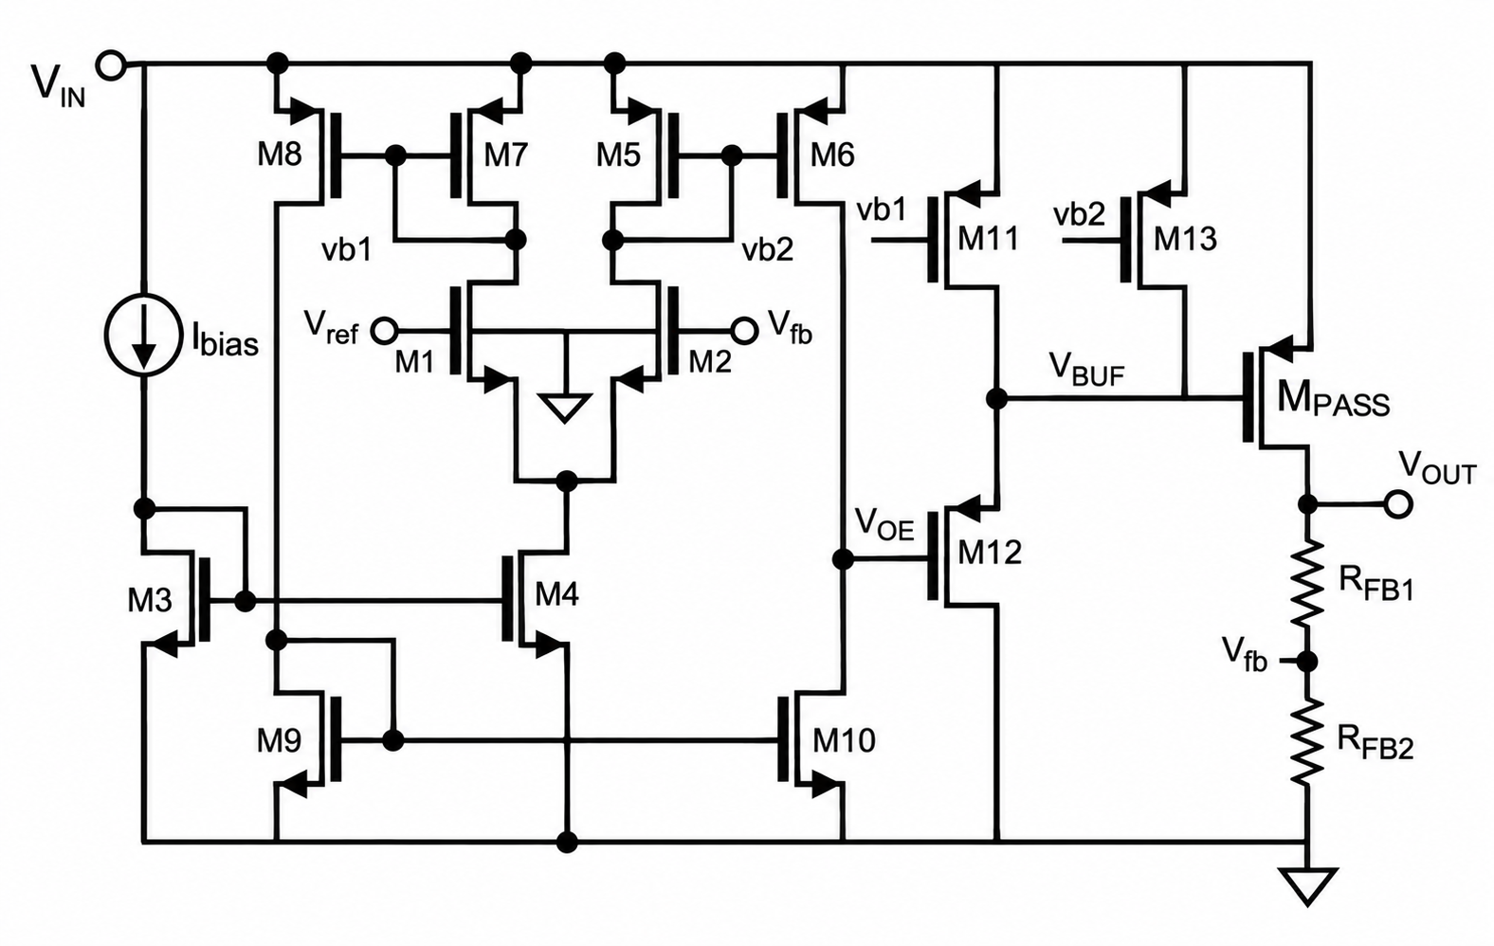
Proposed LDO
CD was introduced which will introduce a zero in LHP which will help to increase Phase Margin by avoiding low frequency pole that caused by Mpass as it has high capacitance
Since MPASS transistor’s Current vary too much with the load, we need a high swing at the gate, so we are going with this architecture

Slide 5
Specifications
Output voltage 1.5V
Input voltage from 1.7V to 2V
Input reference voltage 1.2V
Load current from 10µA to 1mA with 10%error (i.e. 9µA to 1.1mA)
Fastest change in load current 1µs
Output capacitor of 1µF with 20% error (i.e. 0.8µF to 1.2µF)
Temperature in range −40℃ to 125℃
Maximum quiescent current 10µA
Biasing current of 100nA

Slide 6
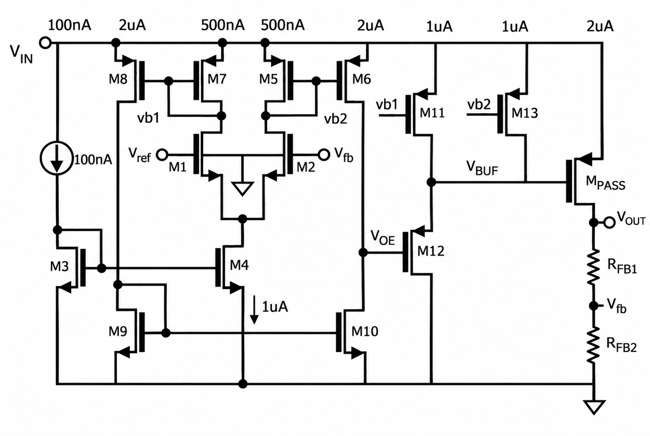
Current distribution in accordance with quiescent current
Disadvantage:
Since it has more Current Branches, more current is required, resulting more power dissipation

Slide 7
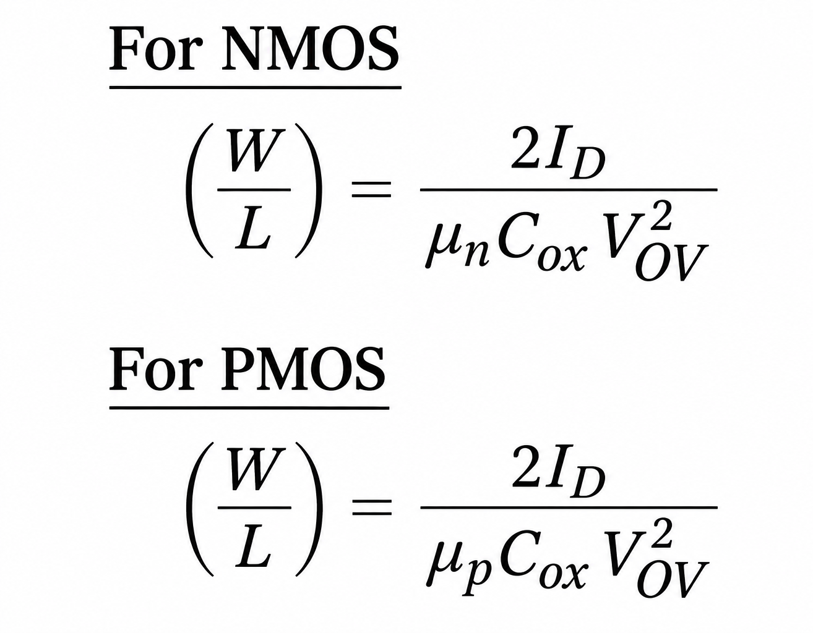
Components size calculation
Here:
μₙCox = 250 μA/V²
μₚCox = 55 μA/V²
Vov_{n} = V_{GS} - V_{TH} = 0.2V and Vov_{p} = V_{SG} - |V_{TH}| =0.2V
→ M₈, M₇, M₅, M₆, M₁₁, M₁₂, M₁₃ and M_{PASS} are PMOS transistors.
→ M₁, M₂, M₃, M₄, M₉ and M₁₀ are NMOS transistors.
Currents in each transistor:
M₃ → 100 nA
M₈, M₉, M₁₀, M₆, M₅ → 2 μA
M₁₁, M₁₂, M₁₃, M₄ → 1 μA
M₁, M₂, M_{5,} M₇ → 500 nA

Slide 8
Sizing of M₁ and M₂
The drain current is
I_{D1,2} = (½)μ_{n}C_{ox} (W/L)_{1,2} (V_{GS} − V_{TH})²
Rearranging,
(W/L)_{1,2} = 2I_{D} / [μ_{n}C_{ox} (V_{GS} − V_{TH})²]
Since I_{D} = 500n, Vov_{n} = (V_{GS} − V_{TH}) = 0.2
Therefore,
(W/L)_{1,2} = 0.1
Here
μ_{p}C_{ox} = 250 μA/V²
μ_{p}C_{ox} = 55 μA/V²
Vov_{n} = V_{GS} - V_{TH} =0.2V

Slide 9
Sizing of M₃ and M₄
The drain current is
I_{D} = (½)μ_{n}C_{ox} (W/L) (V_{GS} − V_{TH})²
Rearranging,
(W/L) = 2I_{D} / [μ_{n}C_{ox} (V_{GS} − V_{TH})²]
Vov_{n} = (V_{GS} − V_{TH}) = 0.2
I_{D3} = 100nA →(W/L)₃ = 0.02
I_{D4} = 1µA →(W/L)₄ = 10x0.02
Here
μ_{p}C_{ox} = 250 μA/V²
μ_{p}C_{ox} = 55 μA/V²
Vov_{n} = V_{GS} - V_{TH} =0.2V

Slide 10
Sizing of M₉ and M₁₀
The drain current is
I_{D} = (½)μ_{n}C_{ox} (W/L) (V_{GS} − V_{TH})²
Rearranging,
(W/L) = 2I_{D} / [μ_{n}C_{ox} (V_{GS} − V_{TH})²]
Vov_{n} = (V_{GS} − V_{TH}) = 0.2
I_{D9,10} = 2µA →(W/L)_{9,10} = 0.4
Here
μ_{p}C_{ox} = 250 μA/V²
μ_{p}C_{ox} = 55 μA/V²
Vov_{n} = V_{GS} - V_{TH} =0.2V

Slide 11
Sizing of M₅, M₆, M₇, M₈, M₁₁ and M₁₃
The drain current is
I_{D} = (½)μ_{p}C_{ox} (W/L) (V_{SG} − |V_{THp}|)²
Rearranging,
(W/L) = 2I_{D} / [μ_{p}C_{ox} (V_{SG} − |V_{THp}|)²]
Vov_{P} = (V_{SG} − |V_{THp}|) = 0.2
I_{D5,7} = 500nA →(W/L)_{5,7} = 0.45
I_{D6,8} = 2µA →(W/L)_{6,8} = 4x0.45
I_{D11,13} = 1µA →(W/L)_{6,8} = 2x0.45
Here
μ_{p}C_{ox} = 250 μA/V²
μ_{p}C_{ox} = 55 μA/V²
Vov_{p} = V_{SG} - V_{TH} =0.2V

Slide 12
Sizing of M₁₂ and M_{PASS}
The drain current is
I_{D} = (½)μ_{p}C_{ox} (W/L) (V_{SG} − |V_{THp}|)²
Rearranging,
(W/L) = 2I_{D} / [μ_{p}C_{ox} (V_{SG} − |V_{THp}|)²]
Vov_{P} = (V_{SG} − |V_{THp}|) = 0.2
I_{D12} = 1u →(W/L)₁₂ = 0.909
I_{DPASS} = 1mA(max) →(W/L)_{PASS} = 1000
Here
μ_{p}C_{ox} = 250 μA/V²
μ_{p}C_{ox} = 55 μA/V²
Vov_{p} = V_{SG} - V_{TH} =0.2V

Slide 13
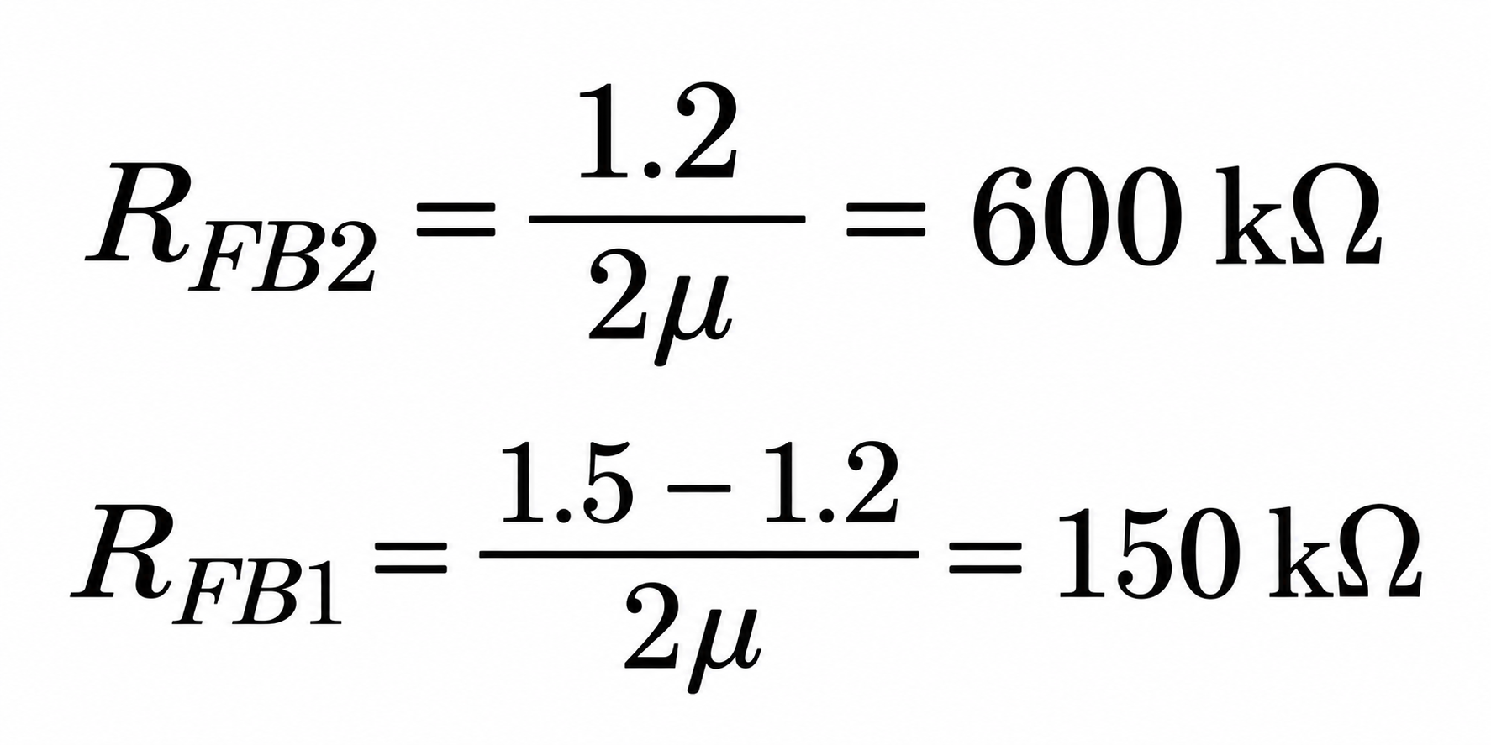
Sizing of components
Transistor | Through Calculation | In Simulation adjustment
M1 and M2 | 0.1 | 4u/400n
M3 | 0.02 | 20u/400n
M4 | 10x0.02 | 20u/400n, m = 10
M5 and M7 | 0.45 | 450n/1.2u, f = 2
M6 and M8 | 4x0.45 | 450n/1.2u,f = 2, m = 4
M9 and M10 | 0.4 | 400n/1u, m= 4
M11 and M13 | 2x0.45 | 450n/1.2u, f =2, m = 2
M12 | 0.909 | 1.6u/400n, f = 2
MPASS | 1000 | 8.5u/280n, f = 40
when number of fingers and multipliers are more than 1, they are mentioned
Library : tsmcN65
Cells: nch_25_mac, pch_25_mac and rppolywo

Slide 14
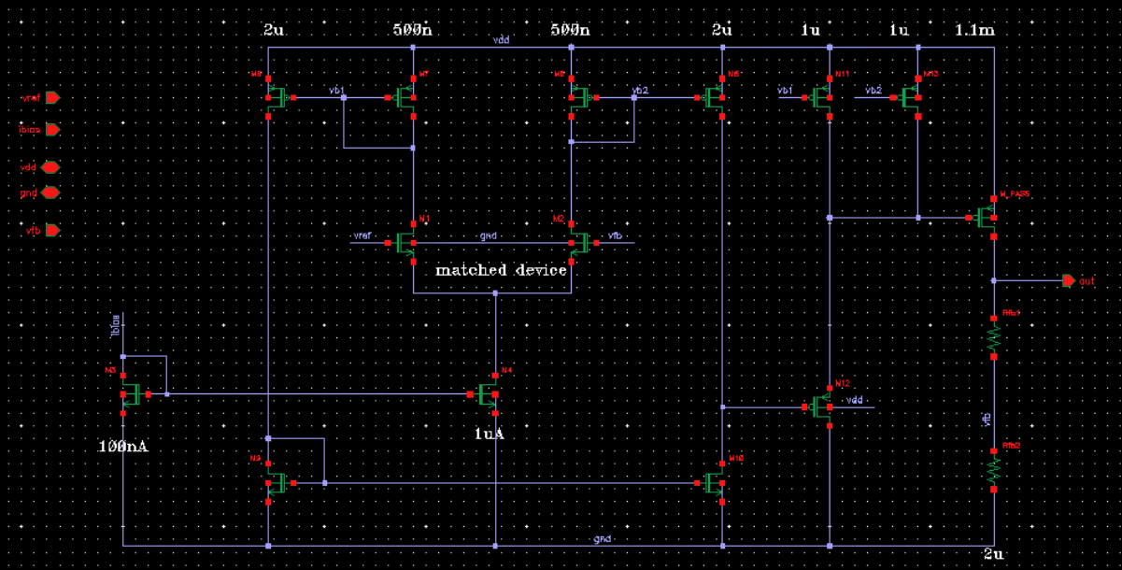
Schematic

Slide 15
PVT Simulations
Load Current varied in 0uA, 9uA and 1.1mA and these values mentioned in the results slides
Parameter | Value
Temperature | -40℃, 27℃, 125℃
Load Capacitor | 800nF and 1.2uF

Slide 16
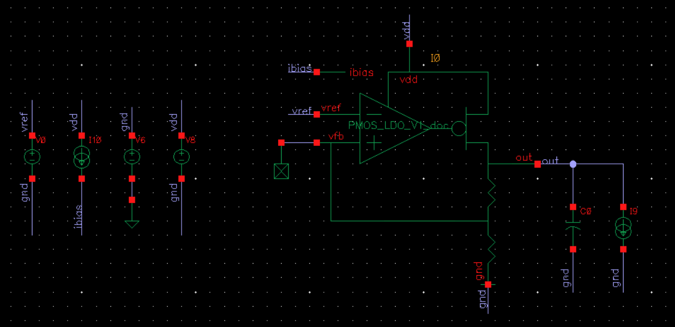
Testbench - DC

Slide 17
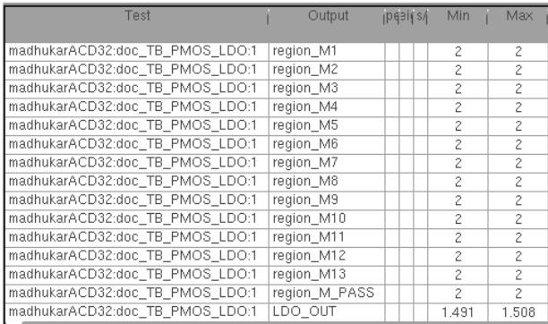
DC PVT - 1.1 mA load

Slide 18
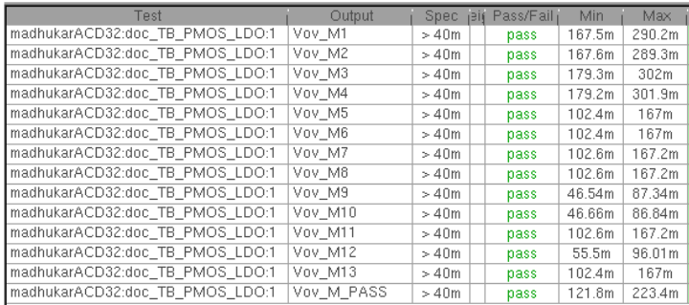
DC PVT - 1.1 mA load
All the transistors in the design are meeting 40 mV overdrive voltage margins

Slide 19
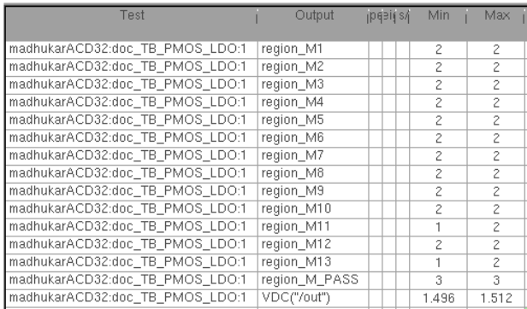
DC PVT - No load
Failing in ff, 125℃, 2V supply corner with load capacitor 800nF and 1.2uF
Failing because we sized M_{PASS} for large load current
Though M11, M13 and M_{PASS} transistors not in saturation, the output voltage produced by the designed LDO is close to 1.5V

Slide 20
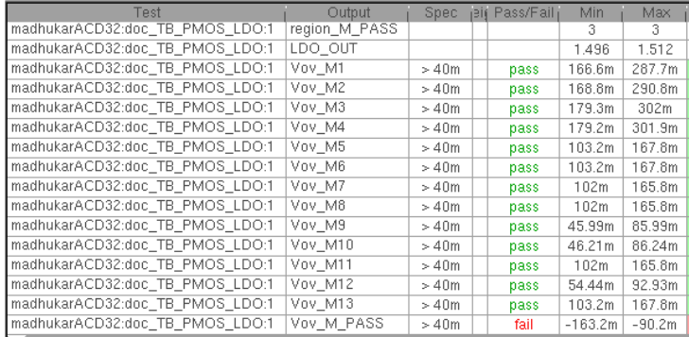
DC PVT - No load
Failing because we sized M_{PASS} for large load current

Slide 21
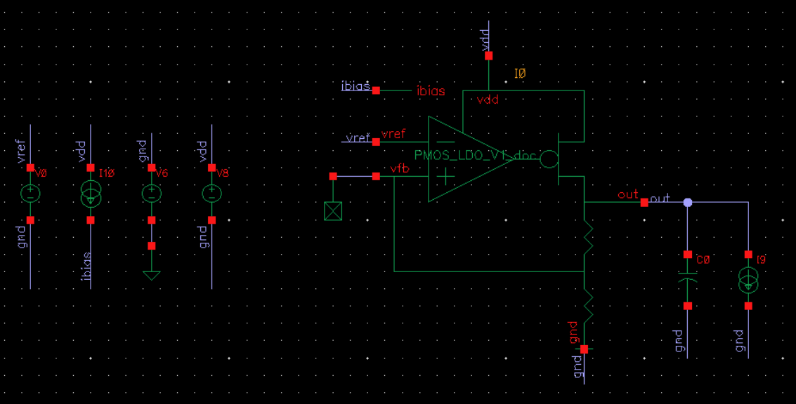
Testbench - AC Analysis(PSRR)

Slide 22
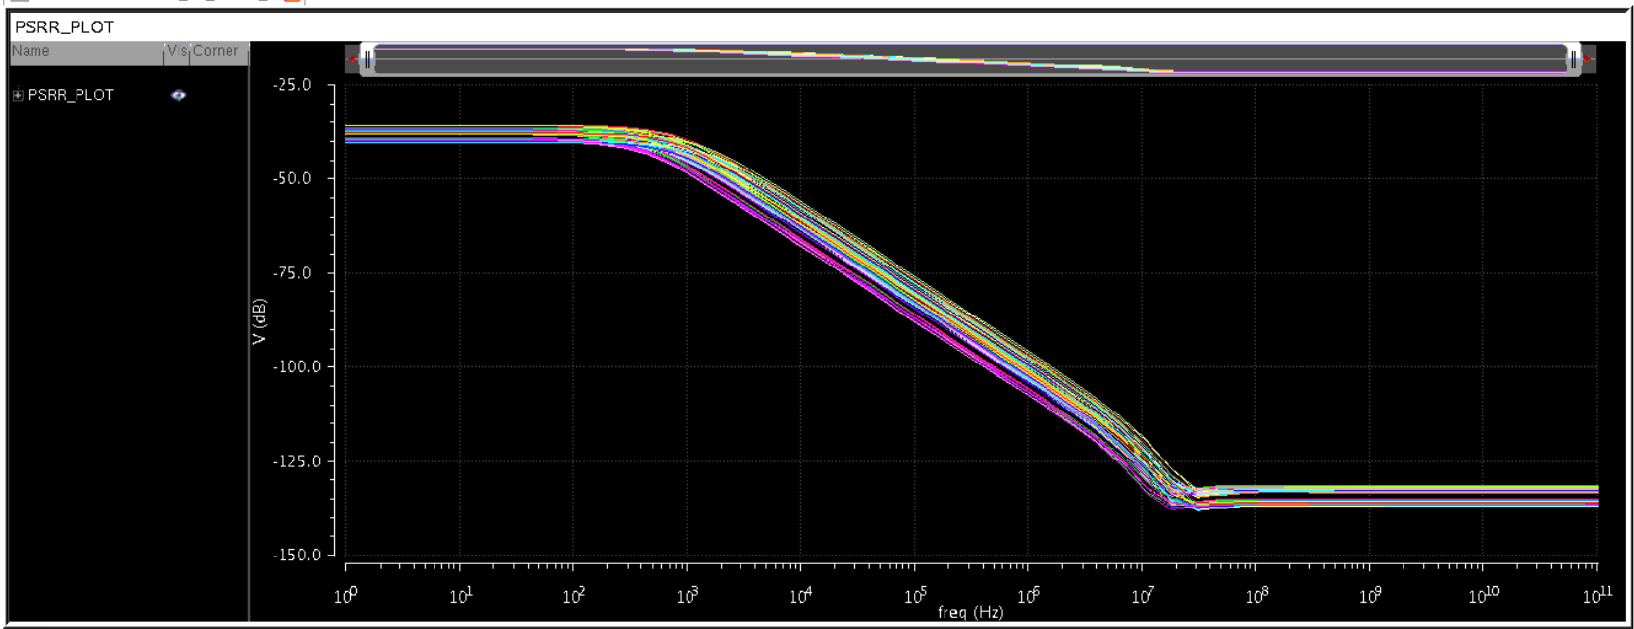

PSRR(PVT) with No Load

Slide 23
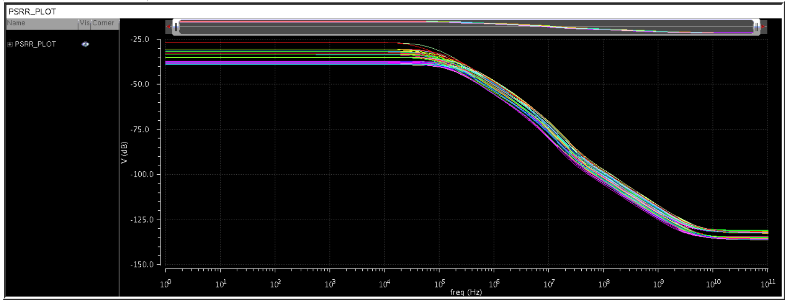

PSRR(PVT) with 1.1 mA Load

Slide 24
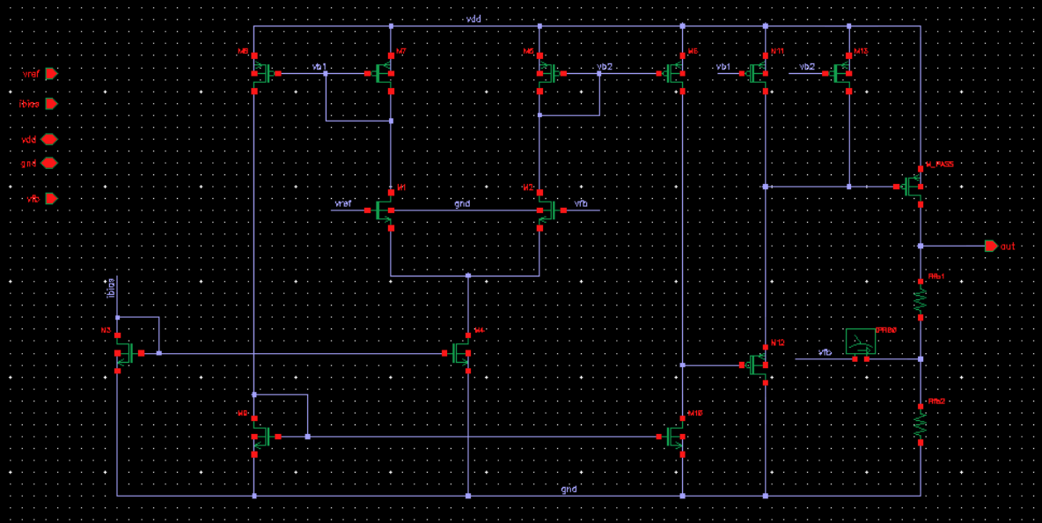
Testbench - Stability
Iprobe was instantiated inside the LDO block

Slide 25
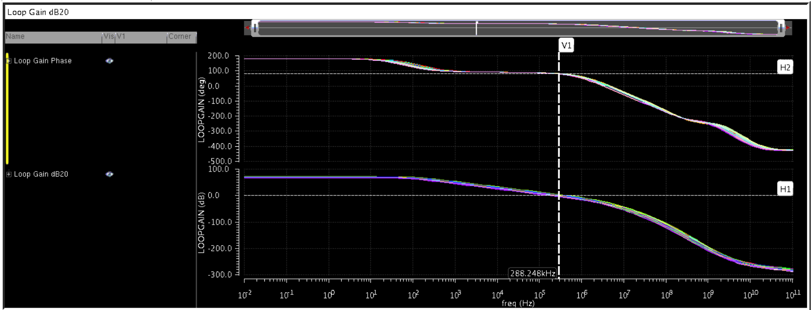
Stability - 1.1mA(PVT)

Slide 26
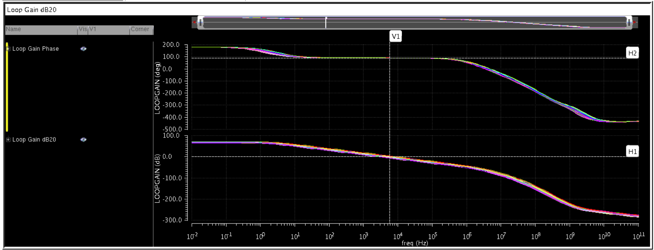
Stability - 9uA (PVT)

Slide 27
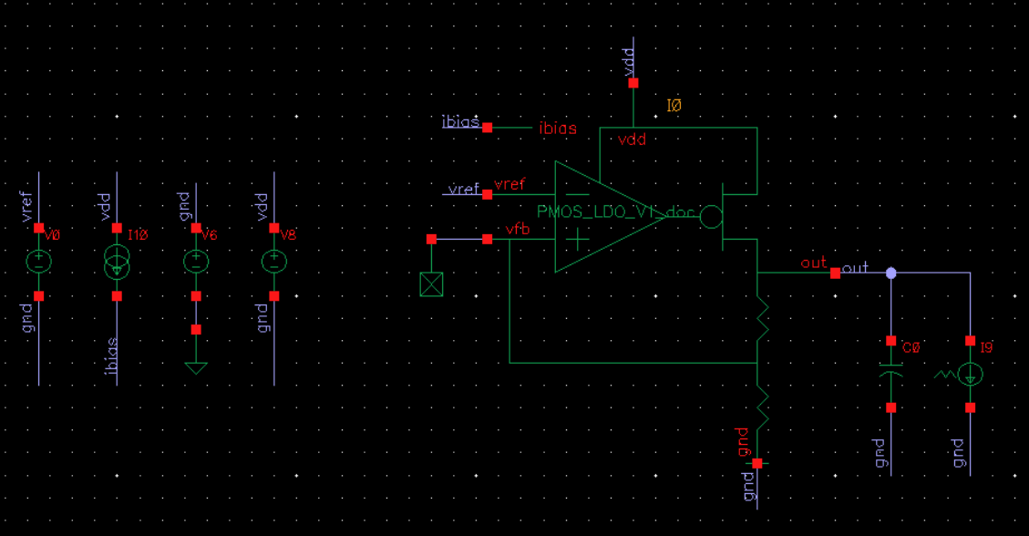
Testbench - Load Transient

Slide 28
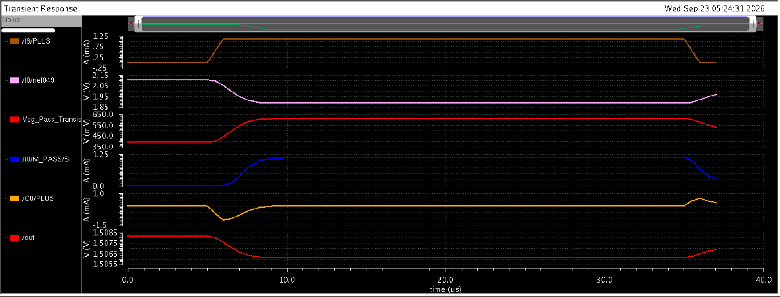
Load Transient - Explanation
Whenever the load current is changing from 9 uA to 1.1 mA in 1us duration and coming back to 9 uA from 1.1 mA in 1us duration, usually the Gate Voltage and
Vsg of pass transistor will take some time to provide the required current to the load so during that time the capacitor will produce and take the current during that time causing very little variation in LDO output voltage as the voltage across the capacitor does not change in quicktime.
Simulation done at tt, 27,VDD→1.7V and load capacitor at 1uF

Slide 29
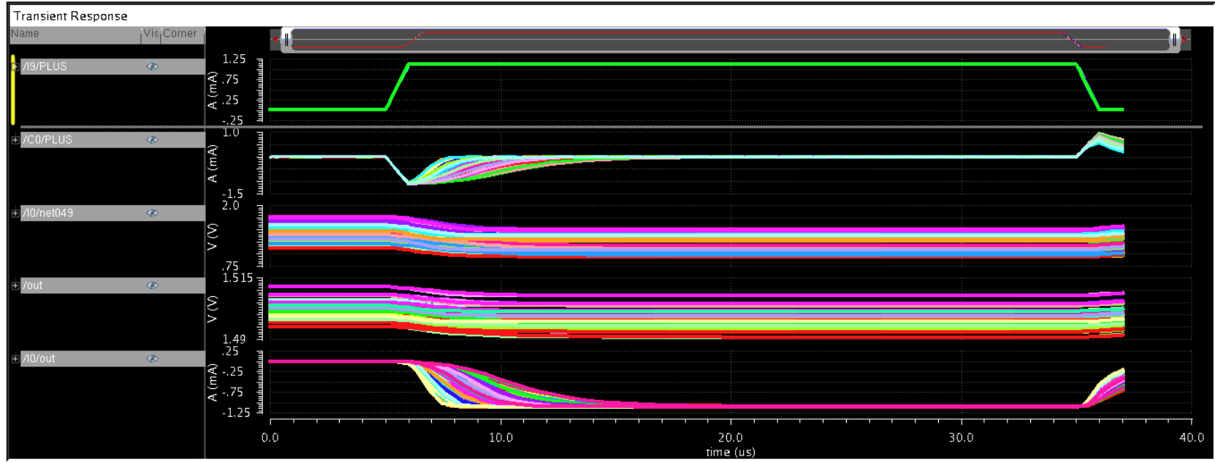

Load Transient - PVT (with Iload of 0 and 1.1 mA)

Slide 30
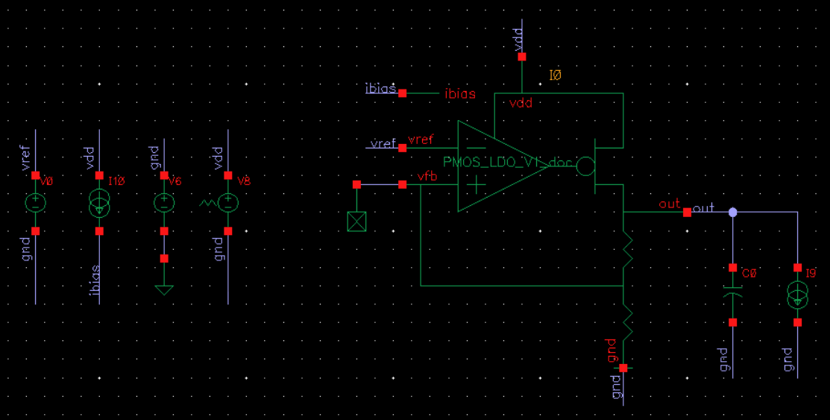
Testbench - Line Transient

Slide 31
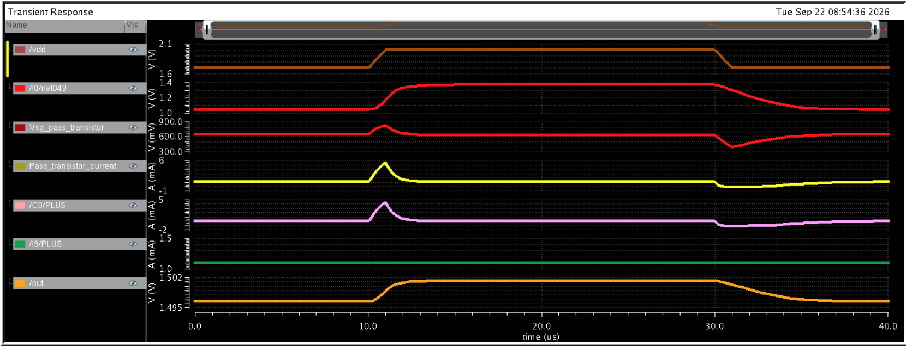
Line Transient - Explanation
Whenever the VDD changes from 1.7 V to 2 V and comes back to 1.7V within 1us duration, the gate voltage and
Vsg of pass transistor will change in such a way to produce defined load current, during that transition the capacitor either sinks or source the current, with respect to pass transistor current to produce defined load current causing very little variation in LDO output voltage
Simulation done at tt, 27,Iload at 1.1 mA and load capacitor at 1uF

Slide 32
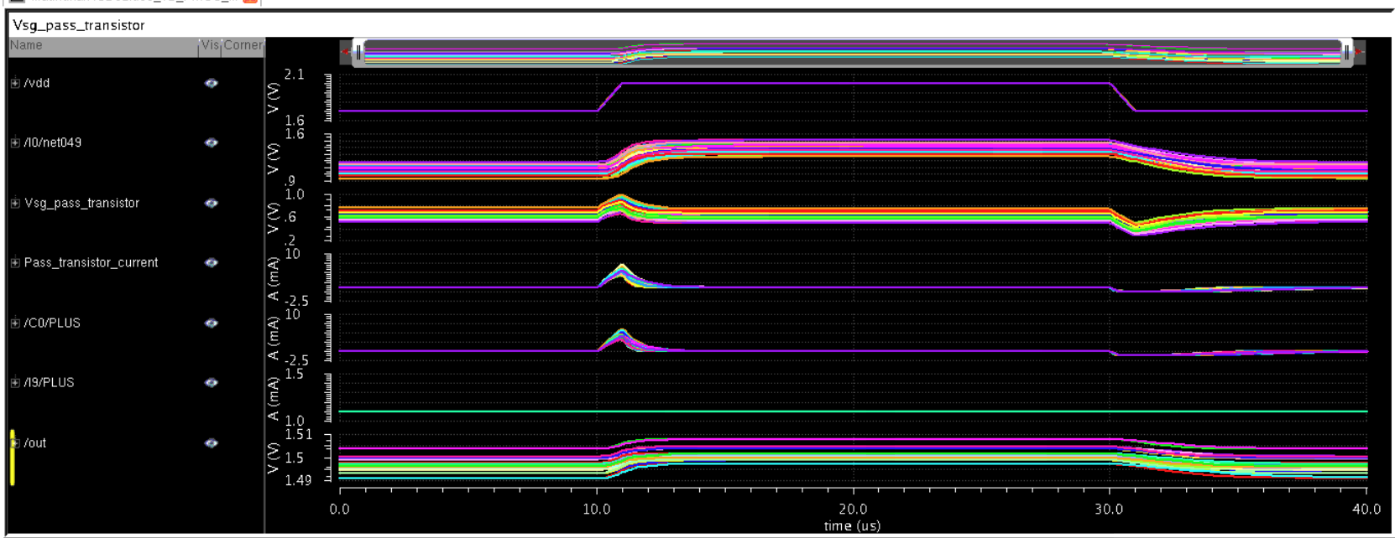
Line Transient - PVT(with Iload of 0 and 1.1 mA)

Slide 33
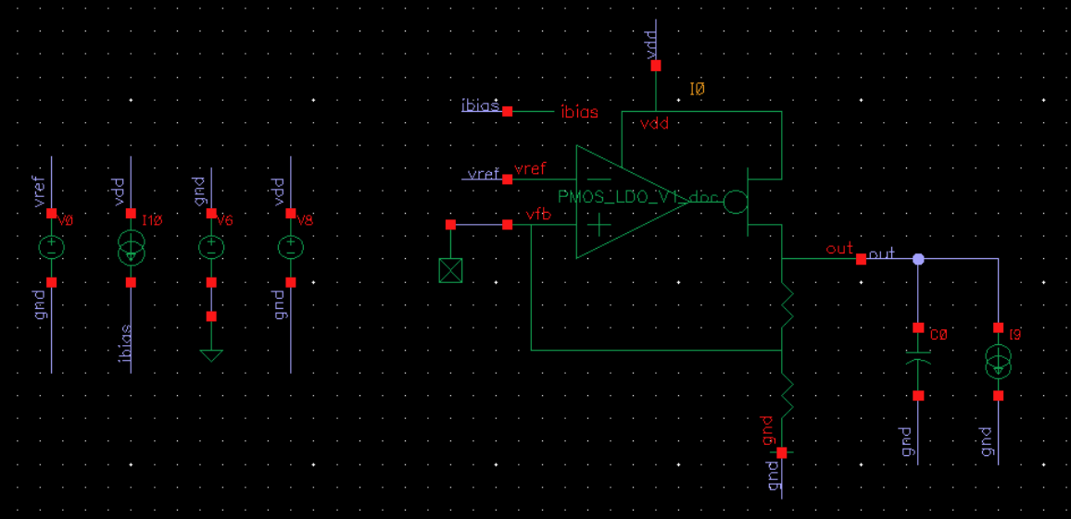
Testbench - Mismatch

Slide 34
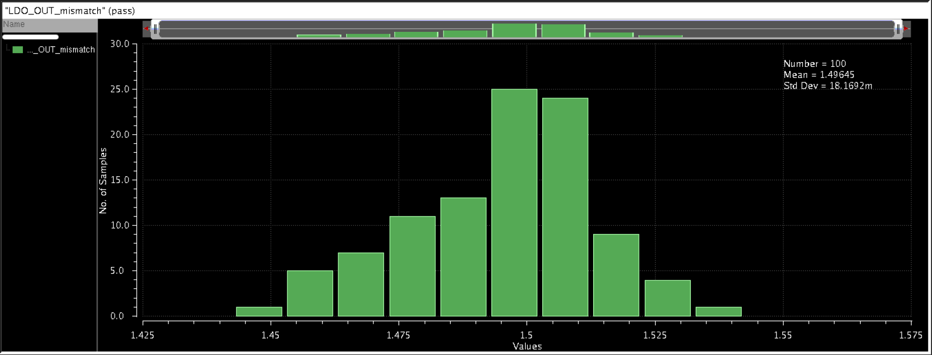
Monte Carlo Simulation
Simulation done at 1.7V VDD, 1.1mA load current, 1uF load capacitor and 27℃ Temperature
The standard deviation is 18.1692mV

Slide 35
Thank you

